Slide 1




SNORT
PROJECT ON CSE406
COMPUTER SECURITY SESSIONAL

Slide 2



OUR GROUP
Fabiha Tasneem
1805072
Sumaiya Sultana
1805079

Slide 3
WHAT IS SNORT?
Snort is a popular free and open-source IDS/IPS system that is used to perform traffic/ protocol analysis and content matching. Snort can be used to detect and prevent various attacks based on predefined rules.

Slide 4
SNORT RULES
Community Rules
Registered Rules
Subscription Only Rules
Customized Rules

Slide 5
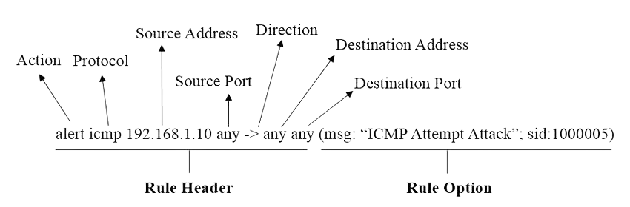
SNORT RULE SYNTAX

Slide 6
FEATURES
Packet Sniffing
Network Intrusion Detection
Packet Logging
Network Intrusion Prevention

Slide 7
PACKET SNIFFING
Packet sniffing is a critical component of Snort's functionality, allowing it to provide real-time insight into network activity, detect anomalies, and enhance network security by identifying potential threats.

Slide 8
INTRUSION DETECTION SYSTEM
Intrusion Detection System (IDS) is a system/host planted within a network to capture traffic and identify malicious activity based on predefined rules, after which, this malicious activity is logged, and a notification is sent to the relevant parties informing them of an intrusion.

Slide 9
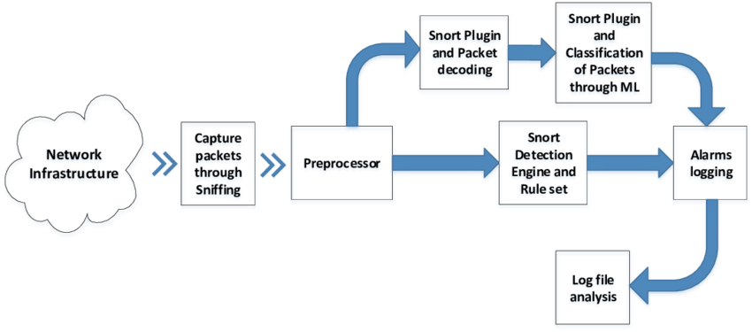
SNORT IDS WORKFLOW

Slide 10
PACKET LOGGING
Packet logging in Snort refers to the process of capturing and recording network packets that match specific rules or signatures defined in the Snort intrusion detection system (IDS) configuration.

Slide 11
SIMULATING SNORT LOCAL RULES
Pinging Ubuntu 20.04 LTS: ping 192.168.0.105
Trying ssh on metasploit2: ssh -oHostKeyAlgorithms=+ssh-dss msfadmin@192.168.0.107
Trying ftp on seed VM: ftp 192.168.0.108 21

Slide 12

THANK YOU

